Slide 1
Attitudes to Fracking in the UK
Source UK Government Public Attitude Survey Aug 2017
Notes:
Well this is the governments attitude tracker that is taken every three months.
As you can see the people opposing fracking nearly double the people supporting fracking.
1 At this point, the government built a question into the survey to find out why the anti-fracking percentage was going up so much. The answer was “we found out about fracking”.
In areas where fracking is threatened repeated surveys show figures of around 80% opposed to fracking. This number is also repeated in Australia and other parts of the world.
I invite you not to take my word for fracking, but to go and do some research of your own and to form your own view.
When you do, there are a few things you need to be aware of.

Slide 2
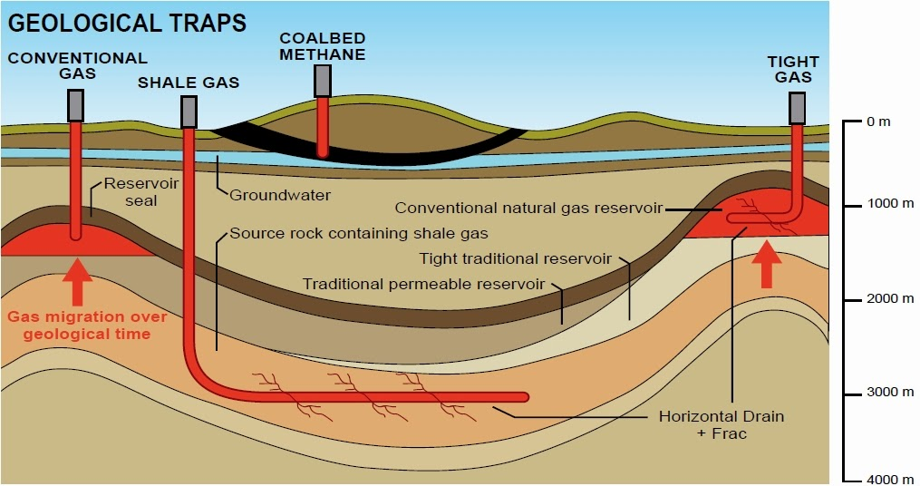
Notes:
So lets have a quick look at the difference between conventional, and unconventional gas extraction.
1 Conventional gas is extracted from a reservoir, created by a dome in an impermeable layer in the earths crust. The gas has migrated there over geological time, being filtered by the ground that it passed through. This is North Sea gas, a very clean form of gas.
2 Shale gas is produce by fracturing the shale, and letting the gas escape to be piped out to the surface. We will look at this in more detail shortly.
3 Coalbeds are relatively close to the surface, and are flooded with water. To extract the gas you drill into the coal bed, extract the water, and the gas flows out with the water.
Tight gas is a bit of a hybrid so to keep things simple we will not discuss this technology.

Slide 3
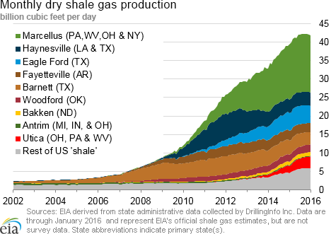
The History of Fracking
1992 - First successful “unconventional gas extraction”
2005 US Energy Policy Act
Fracking companies immunity from:
Compensation and liability act
Resource conservation act
Safe drinking water
Clean air act
National Environmental Policy act - a range of other minor legislation
Notes:
Lets have a look at the history of this technology. Here you can see the explosive growth of shale gas extraction post deregulation in 2005, and a flattening off as gas prices dropped and a number of US gas companies went bankrupt in 2015 / 16 as a result of low gas prices. Whilst fracking has been used since the 1950’s to stimulate oil wells at the end of their lives:
The first successful “Unconventional Gas Extraction” took place in the USA in 1992. Unconventional gas extraction means the ability to drill down, along, and to fracture the rock beds across a large area to release the gas contained within.
Little happened in America until the 2005 Energy Policy Act was passed, exempting the fracking companies from a lot of environmental legislation
Compensation and liability act – fracking companies can not be held liable for damages caused
Resource conservation act – fracking companies need not conserve valuable resources
Safe drinking water – fracking companies can not be held liable for polluting drinking water
Clean air act – fracking companies can not be held liable for polluting the air
National Environmental Policy act - a whole range of other minor environmental legislation that no longer applies to the fracking industry

Slide 4
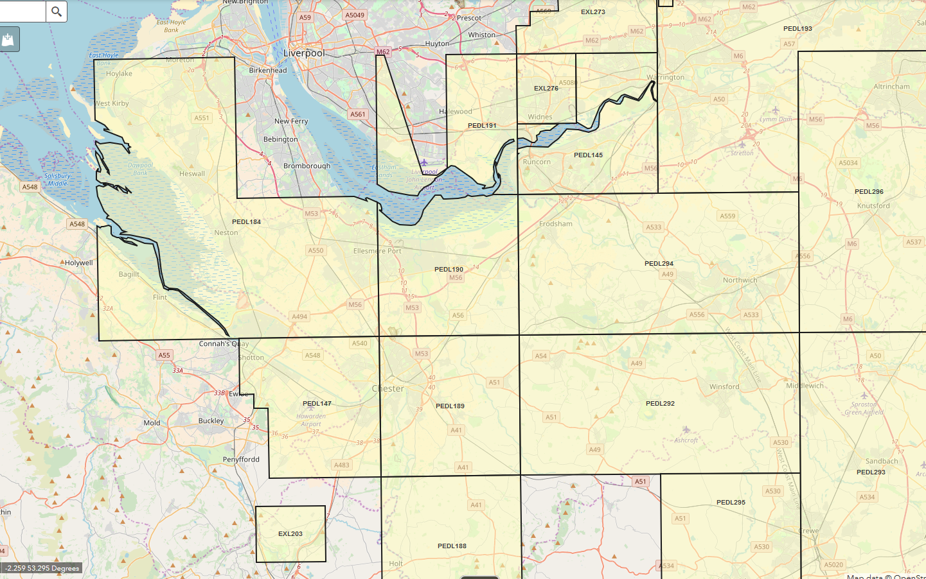
PEDL in Cheshire
193
Liverpool
Warrington
145
296
Red = INEOS
184
294
190
Northwich
The Licensee shall:
obtain 45km of 2D seismic data; and
drill one well to a depth of 1050m.
Start Date 01/07/2008 Initial Term End Date 30/06/2016 Second Term End Date 30/06/2019 Licence Term End Date 30/06/2039
Orange = IGas
Chester
Mold
147
189
292
293
295
188
Crewe
Source: OGA License Map
Notes:
These are the active licenses in Cheshire. The west of Cheshire is licensed to IGas and the east of Cheshire is licensed to INEOS.
Each license also has a work programme associated with it.
1 We are in block 184
2 For example in this block…….

Slide 5
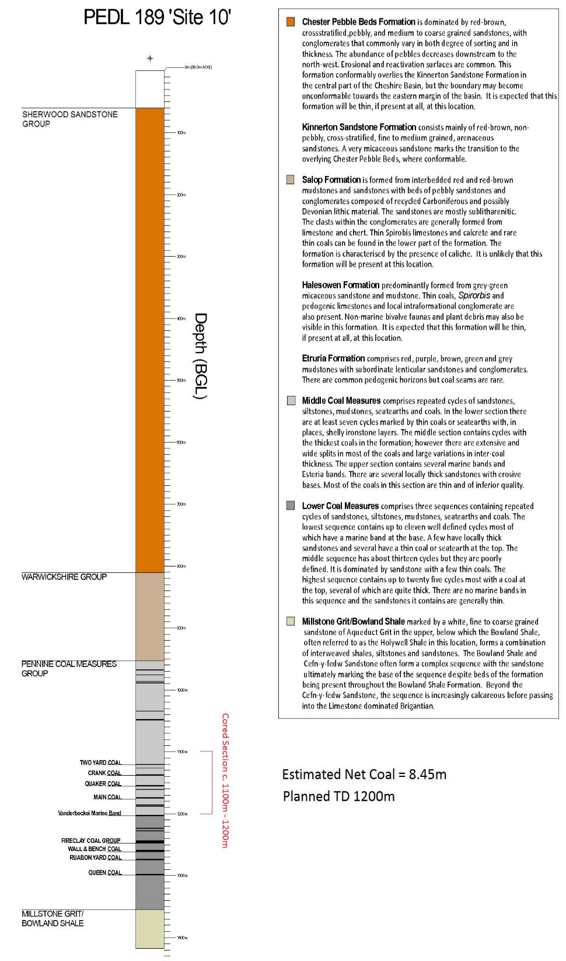
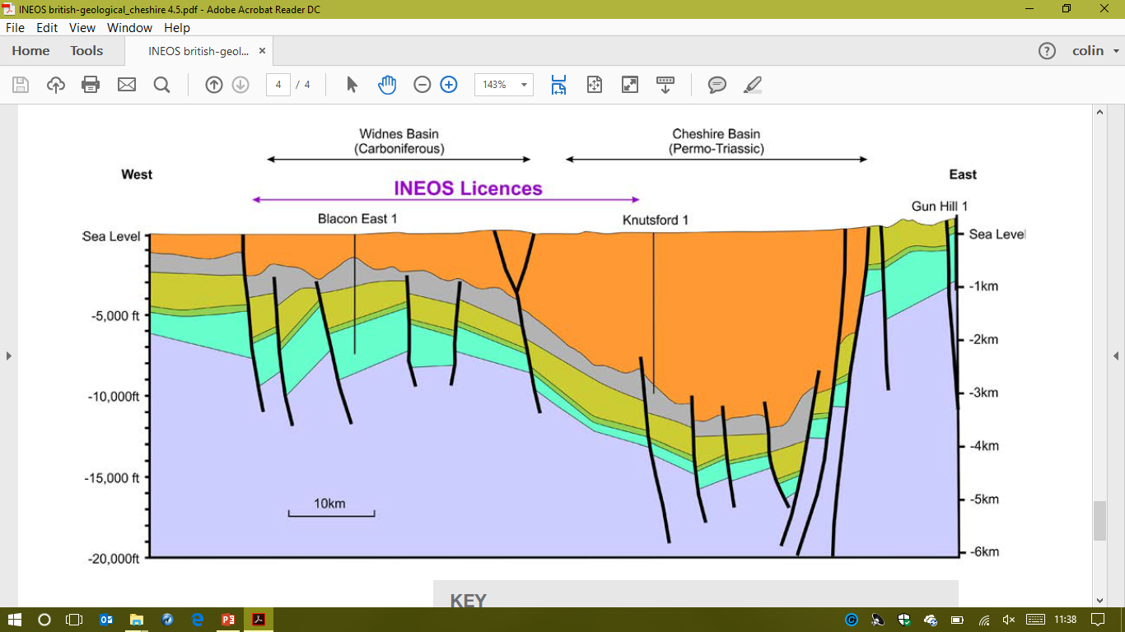
Geology of Cheshire
Sandstone / Pebble Beds
800m
Sandstone / Mudstone
800m
950m
0
1
2
3
950m
Coal Seams
DEPTH (Km)
Drill site near Blacon
Bowland Shale
1350m
1350m
Notes:
This is a view of the ground under Cheshire in a slice from west to east. This image is taken from an INEOS brochure.
This is from a drill that was undertaken in 1982, and is somewhere under the park and ride on Sealand Road.
Beneath the soil there is a layer of sandstone and pebble beds. These are sufficiently porous to allow water to flow. This is the Sherwood Aquifer that supplies water to many villages and farms in Cheshire. It supplies all the water to Chester Zoo. The slanting lines represent faults in the earths crust.
Beneath the aquifer is mudstone, which is less porous and helps to keep the water in the aquifer.
Beneath the mudstone we find coal seams, these are generally very thin and difficult to mine.
Beneath the coal seams we find Boland Shale which is thought to have up to 5% organic matter trapped in it, which due to pressure and temperature over the years has converted into gas.
What is of particular concern around here is the Blacon Basin which is the thickest and shallowest deposit of shale in Cheshire.

Slide 6
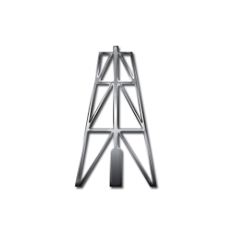
Construction Waste
Non Hazardous ~ 5,400t
Hazardous ~ 3,800t
20,000t Gravel ~ 2mths
Soil 15m
Sandstone / Pebble Beds 800m
(Sherwood Aquifer)
Biocides
Corrosion inhibitors
Gelling agents
FRACK
Water ~ 30,000t
Hydrochloric acid
~ 4,500t
Sand ~ 3,000t
Polyacrylamide
~ 15t
Sandstone / Mudstone 150m
Coal Seams 300m
Bowland Shale 500m
2km
Limestone
Source - Cuadrilla Blackpool Planning Application
Notes:
A well is then sunk into the shale deposits some 2,000m deep.
The well is then deviated along the bed of the shale, to a distance of up to 2 km.
This process generates about 5,400t of non hazardous waste, and 3,800t of hazardous waste. The Non Hazardous waste is drillings containing a non hazardous polymer used as a drilling lubricant. Hazardous waste is drillings containing Oil Based Mud used as a lubricant when drilling through harder rock. This all goes off to landfill.
Once complete the pipe is fractured to allow fluids out into the surrounding rock.
Fluid containing sand is then pumped at pressures of up to 1,000 bar which fractures the shale up to a distance of 500m from the pipe. The aim is to insert sand into the cracks that are created to hold them open to enable the gas to flow out when the water is removed. 30 to 35 thousand tons of fluid is used in the fracking process. This fluid contains Polyacrylamide to suspend the sand, and Hydrochloric acid to dissolve and open the fractures to make the gas flow better.
Additional chemicals are added to control the growth of unwanted bacteria in the ground, corrosion inhibitors to stop the well from going rusty, and other agents to improve the handling of the slurry.

Slide 7



Construction Waste
Non Hazardous ~ 5,400t
Hazardous ~ 3,800t
4,000 HGV
4,000 LGV
Permanent Jobs
220 days over 10 Years
= 0.1 FTE
Flow testing ~3 mths
20,000t Gravel ~ 2mths
Soil 15m
Sandstone / Pebble Beds 800m
(Sherwood Aquifer)
FRACK
Water ~ 30,000t
Hydrochloric acid
~ 4,500t
Sand ~ 3,000t
Polyacrylamide
~ 15t
5 yrs.
Gas ~ 85 Mm3
Water ~ 50,000t
BTEX ~ ?
Radon, Uranium ~?
Chloride ~ 3,500t
Sodium ~ 1,000t
Magnesium ~ 70t
Iron ~ 5t
Lead ~ 4kg
Arsenic ~ 1kg
Sandstone / Mudstone 150m
Coal Seams 300m
Bowland Shale 500m
2km
Limestone
Source - Cuadrilla Blackpool Planning Application
Notes:
A period of flow testing then takes place to determine the gas flow available. The gas is flared off close to the drilling rig. Remember that this is untreated gas that is being flared off, and significant carcinogens and toxins are put into air.
Cuadrilla expect this phase to take up to 3 months at Blackpool.
Finally the gas is connected to the processing plant and production commences.
As you can see you get quite a lot of gas over the lifetime of the well, together with an estimated 50,000t of fluid. The fluid will have been in intimate contact with the shale, and will have absorbed chemicals which will require specialist processing. From EA analysis of flowback water from Lancashire, you can see the volume of some of the chemicals that are expected….. At the moment this fluid can only be disposed of in one of three plants in the UK. The last time I spoke to INEOS they plan to use a processing plant in Glasgow.
As you can imagine, these volumes require quite a lot of truck movement. Again Cuadrilla information suggests that this will be 4,000 HGV movements and another 4,000 LGV movements.
Cuadrilla also indicate that only 0.1 of a Full time job will be created once the well is in production, so you can see where most of the jobs are.

Slide 8
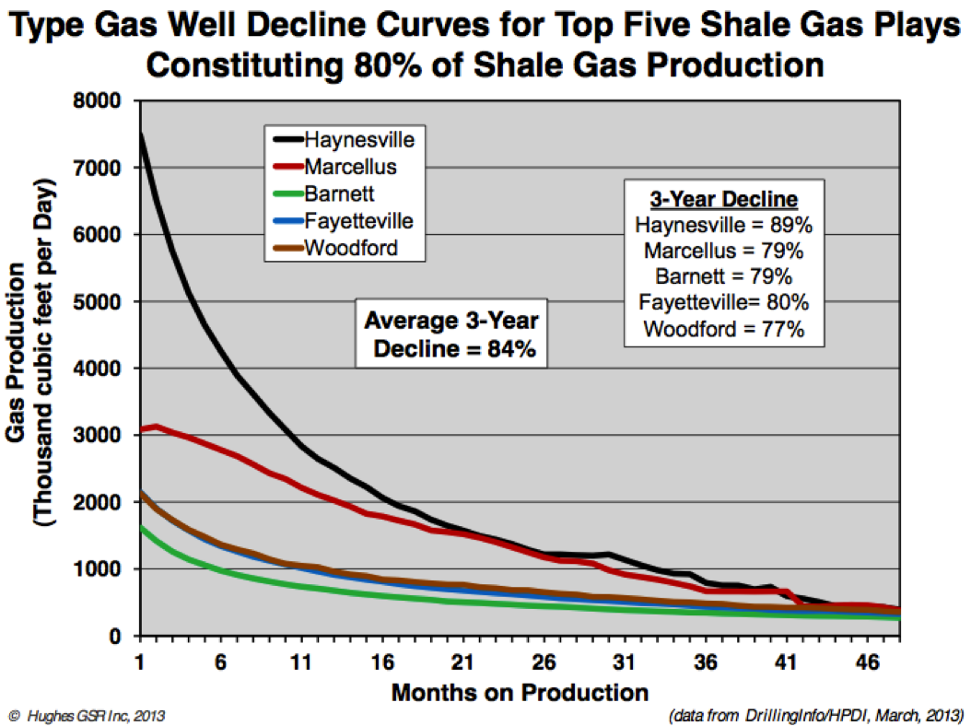
Well Lifetime
85% of the gas in first three years
Wells last
5 to 10 yrs.
Notes:
1 The graph shows that gas production declines rapidly – between 65% and 85% of the total gas in 3 years.
Because of the rapid decline in well production, new ones are constantly required and so the industry needs to open up new wells on a “rolling wave” to keep production flowing.
2 Most wells last for 5 to 10 years after which they are abandoned.

Slide 9
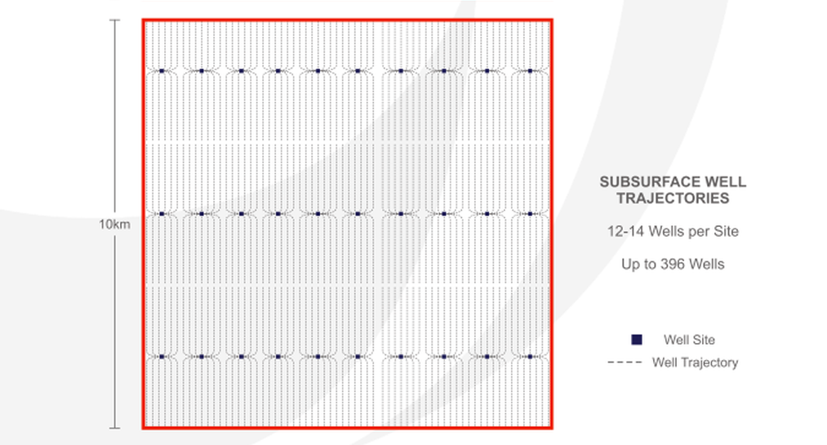


How Many Wells are Needed?
Little Stanney
1,500,000 HGV
1,500,000 LGV
12 Million Tons Water
24 Liverpool Cathedrals
Up to 396 wells
30 Sites / 100 km2
Chester
Source: INEOS invitation to tender 6/5/2016
Notes:
Because the frack can only extend 2 km, a lot of wells are required to extract the gas from the ground.
This is a document that INEOS went out to tender with in 2016. As you can see the sites fall on a matrix of approximately I km by 4 km. Each site containing 12 to 14 wells.
This amounts to 396 wells in a 10km square, which is the about the distance between here and the Vauxhall Factory in Ellesmere Port.
As we have seen each well requires 4,000 truck movements, this 10 km square will require in the region of 1.5 million HGV movements, and another 1.5 million LGV movements to create and service.
There is also 12 million tons of water from our drinking water supply, which is a little difficult to visualise. Try thinking of 24 Liverpool Anglican Cathedrals. All of this water is returned and has to be disposed of.
In reality this is not going to happen because houses, villages and water features on the landscape will reduce this ideal plan, but you can understand the numbers of wells and truck movements are required for production.
What does this look like you may ask.

Slide 10
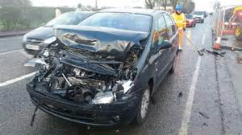
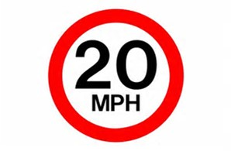
Road Traffic Accidents
4,000 HGV
4,000 LGV
per well
Heavily fracked counties showed 45-47% higher fatalities than non-fracked counties in the USA
- Graham 2015
Preston New Road
– March 2017
Notes:
Clearly if we are moving so many HGV’s, accidents will happen, particularly in small country roads where a lot of these movements will take place.
Research in the USA found that counties with fracking had a 45 to 47% higher fatality rate than counties without fracking.
Due to the number of serious crashes outside the Blackpool site the council has had to impose a 20mph speed limit on one of the main roads into Blackpool which was previously 50 mph. So the first thing you can expect is traffic disruption
It is interesting to note that this was one of the reasons that the Blackpool council rejected the planning permission, which was overridden by the government to allow fracking on this site.

Slide 11
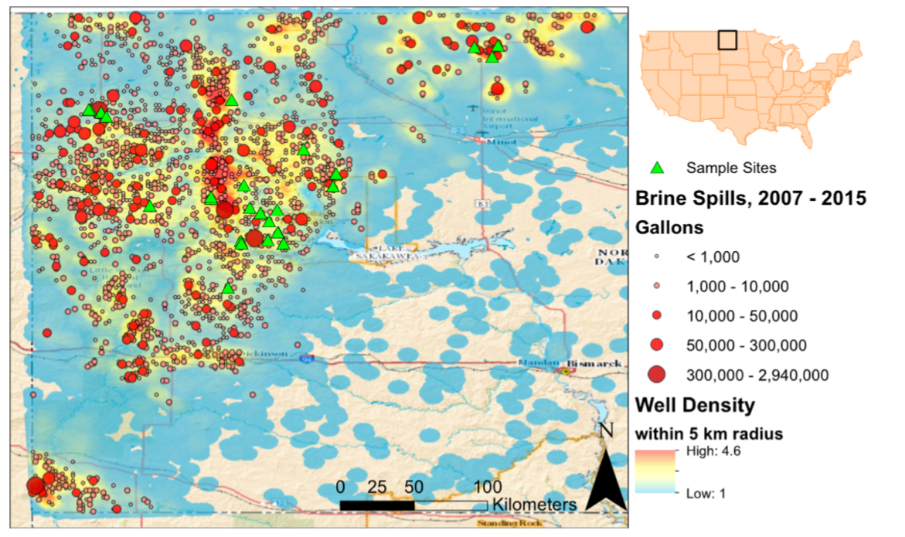
Surface Water Contamination
3,900 spills reported since 2007 in North Dakota
The study found high levels of contaminants remain in streams up to four years after the spill
“Our data show that the brines are enriched in metals, and other potential contaminants (Se, V, Sr, B, Mn, Ni, Cd, Cu, Zn, Ba, Pb)
that have human and ecological health implications”
Source:
Duke University, Pennsylvania 2016
Notes:
Most of the surface water contamination is caused by spillage, which is inevitable when you are dealing with such huge volumes of fluids.
A study by Duke University published in April 2016 found 3,900 fracking spills in North Dakota are giving rise to widespread contamination of land and water courses which remain for several years after the spill.
The study concluded that because of the dangerous chemicals found there are significant human and ecological implications.

Slide 12
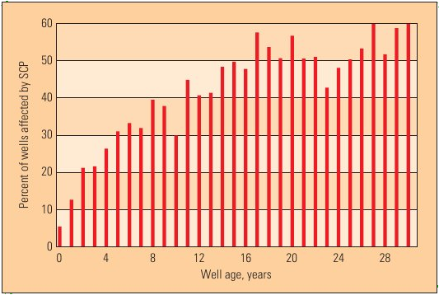
Well Failure
7% fail immediately
50% fail over 15 years
- all fail eventually!
Source: USA Minerals Management Service (2003)
Notes:
This is the result of a survey by the USA Minerals Management Service, a US Government Agency. They reviewed 6,000 conventional wells for leakage.
Many surveys indicate that 7% of wells fail immediately, and as you can see 50% fail in within 15 years, with all wells failing eventually. Australian work confirms low risk of failure up to 15 years, medium risk of failure between 15 and 75 years and almost certain failure over 75 yrs. At this point in time 43% of north sea wells are showing signs of failure.

Slide 13
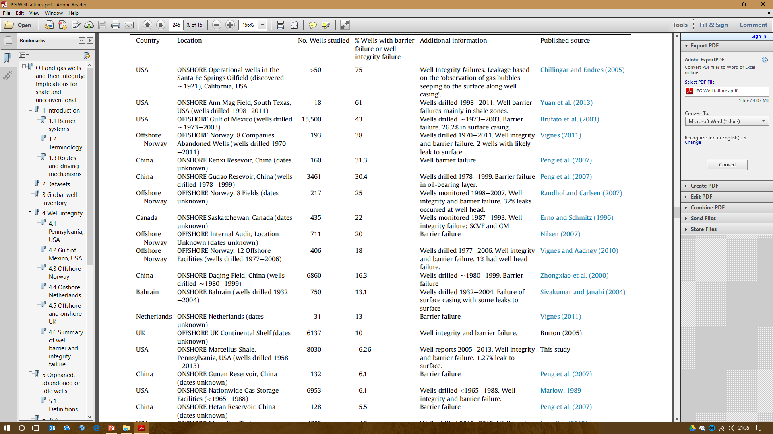
Aquifer Contamination
Who will look after these wells in 100 years?
Source: Marine and Petroleum Geology (2014)
Notes:
Just to reinforce the point this is a review of failing wells from around the world as published in the Marine and Petroleum Geology Journal in 2014.
We can see failure rates of 61% in Texas. One of the things that the industry says is that we will do it better in Europe.
2 Well the evidence does not support it. It seems as though we have failure in 38% of the wells in the North Sea.
3 My concern is who looks after these wells in 100 years time. This is a time bomb we are leaving for our grandchildren.

Slide 14
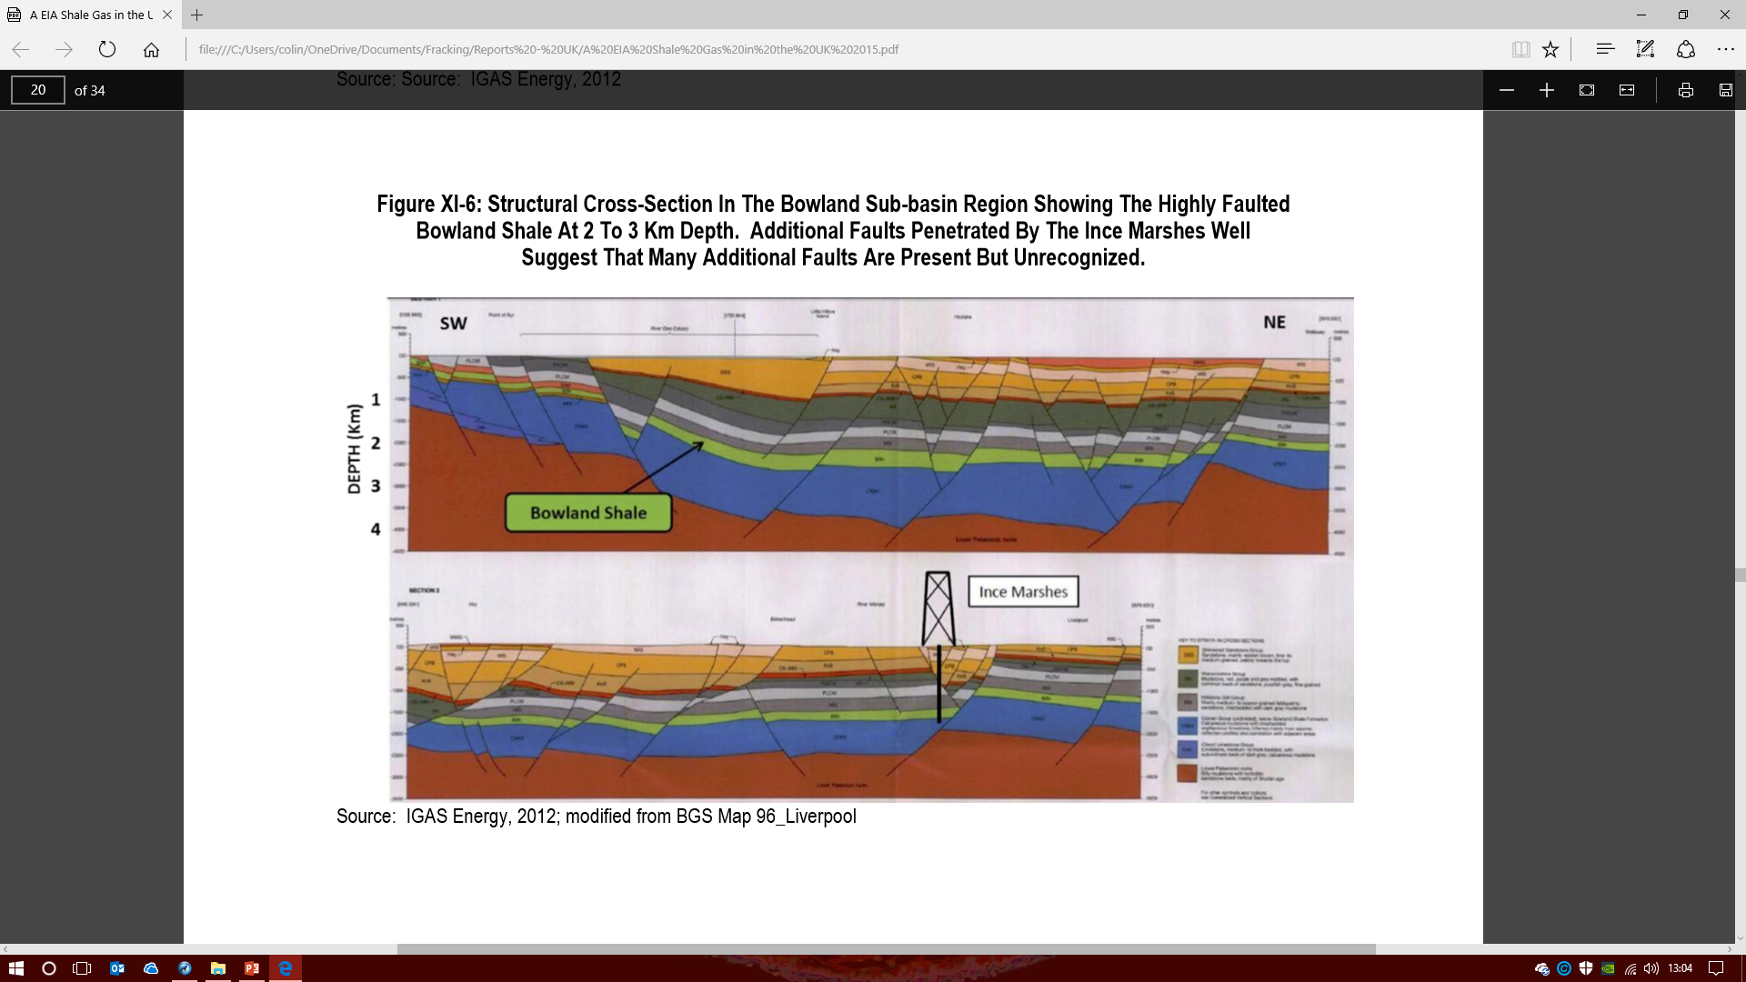
Aquifer Contamination
Seepage through faults is
expected over one to two generations
- Professor David Smyth
Cheshire is faulted 500x more
than fracking areas in the USA
800m
950m
Source: US Energy Agency Report (2015)
Notes:
There are various forms of failure……..3,4,5,6 Initially this will be a small seep of gas or fluid that will increase over time.
Longer term the well will dissolve into rust, and the cement around the casing will crack and fail leading to migration of gas and fluid. Over geological time the earth will flex causing much greater failures than observed to date.
Complaints about contaminated water in Pennsylvania from fracking run between 200 and 300 per year.
2 What is concerning is that the UK experiences 500 times more faults than the USA.
3 Professor David Smythe from Glasgow University who spent a lot of his career helping to develop the North Seal oil and gas industry considers the development of fracking onshore as a major environmental threat, and provides expert witness to inquiries. He has evaluated flow rates in Cheshire faults, and considers that migration of fluids to the surface will take one to two generations.

Slide 15
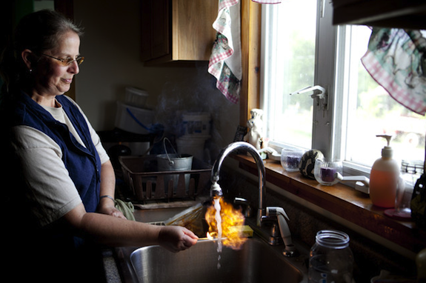
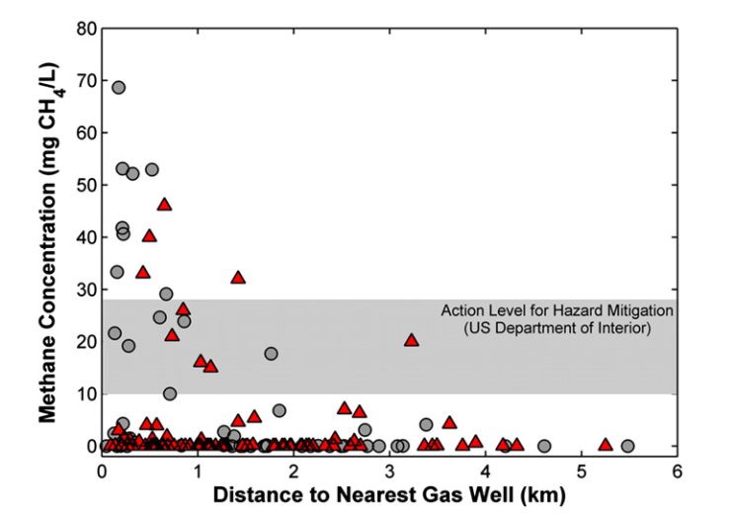
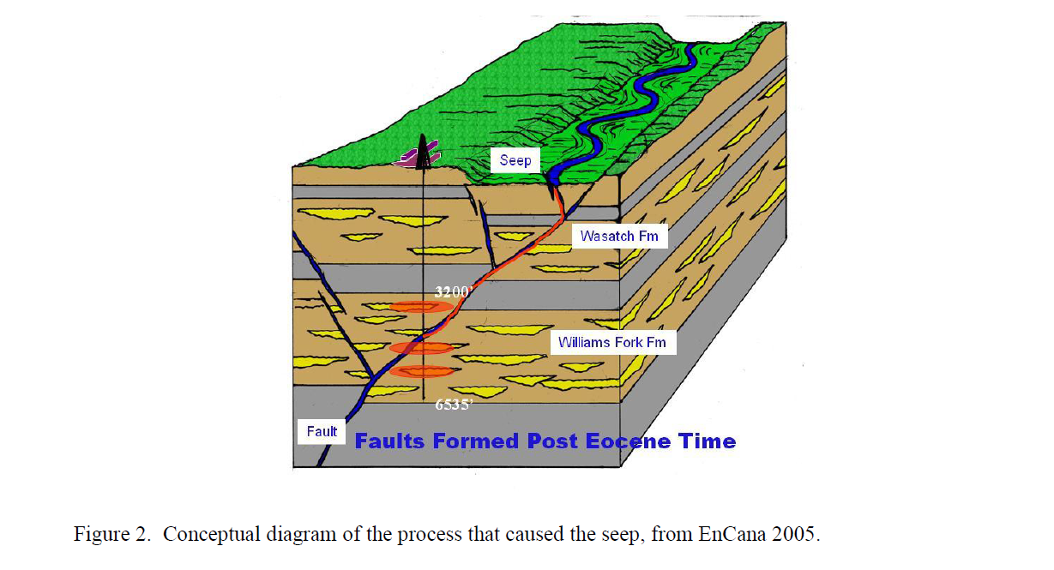
Methane in Water
Source: Duke University, Pennsylvania (2013)
Notes:
I am sure you have all seen the one where someone turns the tap on and sets the water on fire!
Duke University in America did a survey in 2013. There are also many other surveys showing the same results.
1 As you can see, if you live 1km from a well, and take your water from a borehole, you have a much higher chance of methane, ethane, and propane in the water.
115 of 141 wells were found to have higher than normal levels of gasses in them, and a significant number are in the hazard zone of harm to health and explosion causing damage to property, which has happened.
The concern is that these gasses are the precursors of greater flows, and other contaminants caused by fracking operations.

Slide 16
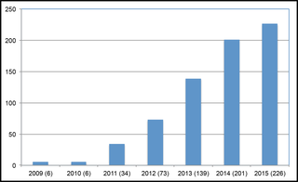
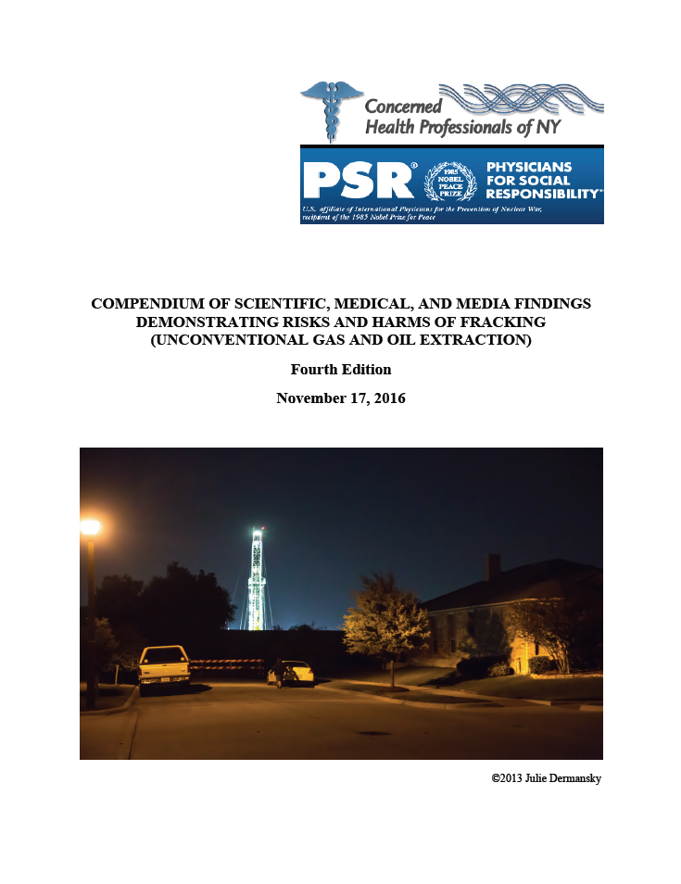
Health Impact
“As the number of gas wells increase in a community, so do rates of hospitalization. Drilling and fracking operations are correlated with elevated motor vehicle fatalities, skin and respiratory problems, emergency room visits, infant deaths, birth defects, and low birthweight.”
Source:
Concerned Health Professionals report 2015
“There is no evidence that fracking can operate without threatening public health directly or without imperilling climate stability upon which public health depends...”
Source:
Concerned Health Professionals report 2016
“Mounting evidence show harm to the environment and human health……….
we have no idea what the long term implications are……..
ignoring this evidence is not an option anymore.”
Source:
American Journal of Public Health report 2016
Notes:
There are hundreds of studies relating to health impacts of fracking. 226 in the USA 2015, 0ver 230 in the first six months of 2016. The number has risen exponentially from the first few reports appearing in 2008, and long term effects become obvious.
This report provides a summary of all the major studies carried out in America – it runs to 209 pages!
Its summary in 2015 was……
In 2016 it called for a complete ban on the industry.
The American Journal of Public Health reported ………….It is also calling for a ban on the industry.

Slide 17
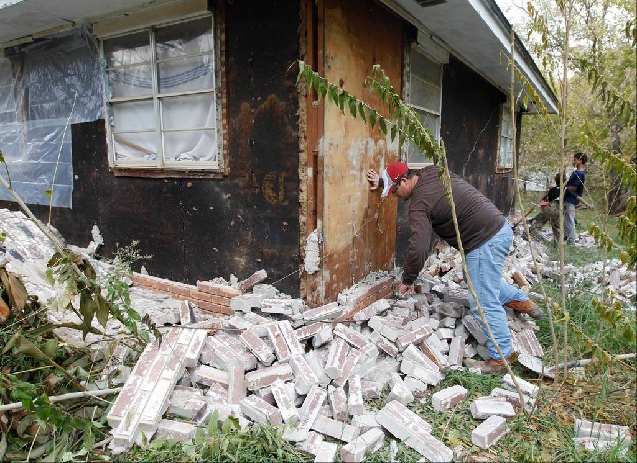
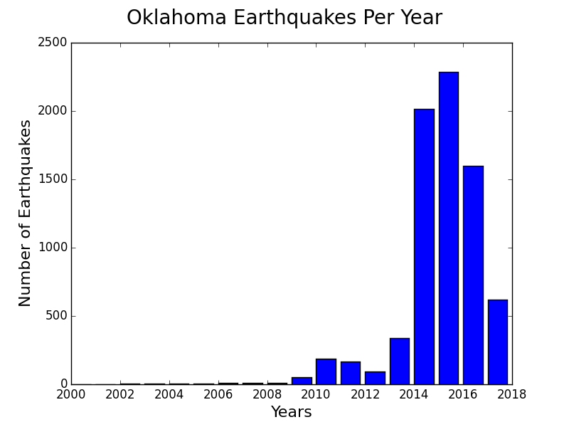
Earthquakes
Magnitude 5.7 Prague Oklahoma 2001
Notes:
Fracking processes trigger Earthquakes?
California has been severely hit with earthquakes due to the fracking industry.
Including earthquakes over 5 magnitude.
The only frack in UK – 2011 -Lancashire, Caudrilla caused 50 minor earth tremors with one 1.5 and one 2.3 magnitude, which caused minor damage to local property. One of these deformed their own well due to deformation.

Slide 18
Gold Standards
Fracking sites now exempt from COMAH regulations
(Control of Major Accident Hazard)
The cuts to the Council’s, Environmental Agency, the Health and Safety Executive gives significant concern as to whether they can regulate effectively.
2017 Conservative manifesto included a clause to exclude exploration from planning permission, and production decided by the government directly.
Notes:
A watering down of our supposed gold standards are already taking place: For example:
Although methane is a substance that falls under the COMAH regulations in 2015 the government changed the legislation to exclude onshore gas wells.
The government has cut the Council’s the Environmental Agency and the Health and Safety Executive to the point that there is significant concern over their ability to regulate effectively.
If you read the recent Conservative manifesto, it included a section on how fracking will become permitted development. So whilst you struggle for months to get a house extension through the local planning department, a developer can set up a test rig without planning permission. Once they have run 4,000 HGV’s past your front door, then they only need to apply to an office in Whitehall to turn it into a full production facility. This is a major threat to the local democracy that we have established in this country over the last several hundred years. No industry should be above democracy.
You may ask what other impacts this industry may have upon you.

Slide 19
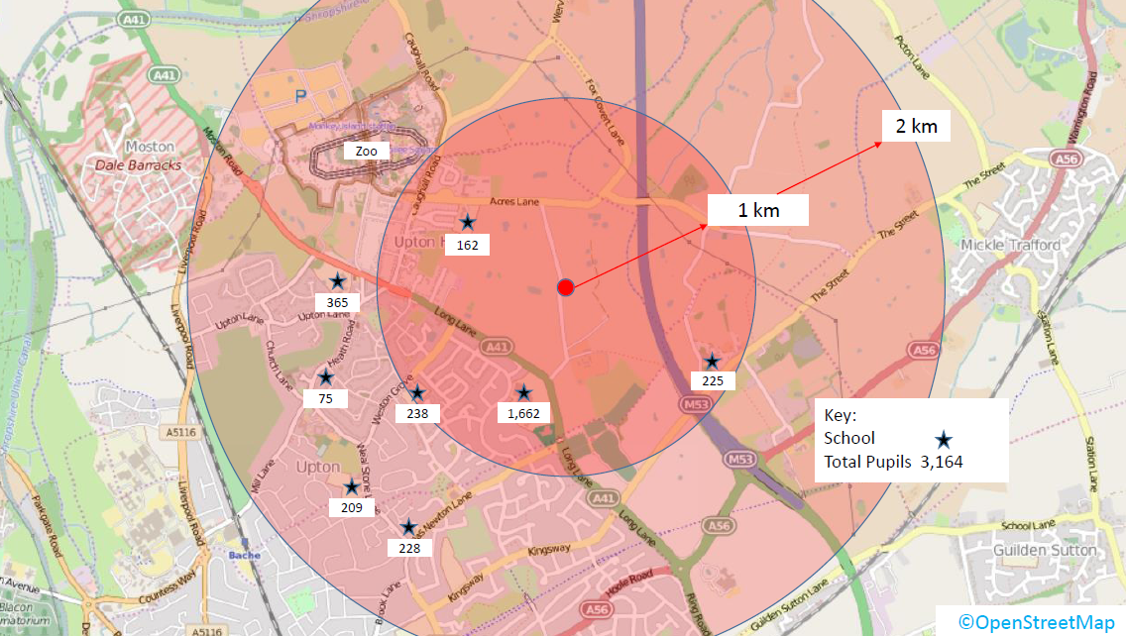
Gold Standards - Upton Near Chester
Environmental Health England will not accept evidence from the USA
and will only act when they observe ill health in the UK
No “Setback” in the UK 2 km in NSW Aus.
Notes:
This is a well planned by IGas on the outskirts of Chester. You can see schools and residential houses. Over 2,000 pupils within 1 km, and over 3,000 pupils within 2 km. Also Chester Zoo is just over 1 km away which also draws all its water from the aquifer that the well would pass though.
Comparing that with Australia, In 2013 NSW government introduced a 2km exclusion zone around existing and future residential areas, which they further extended in 2014 to include equine and wine industries. A report in 2016 in the USA recommended that the current exclusion zone of 200 ft. should be extended to 2,000 ft due to the impact of explosions and airborne pollutants.
This government will not do the same. Public Health England say that they cannot use the evidence from other countries and will only act when they have evidence of ill health in the UK.

Slide 20
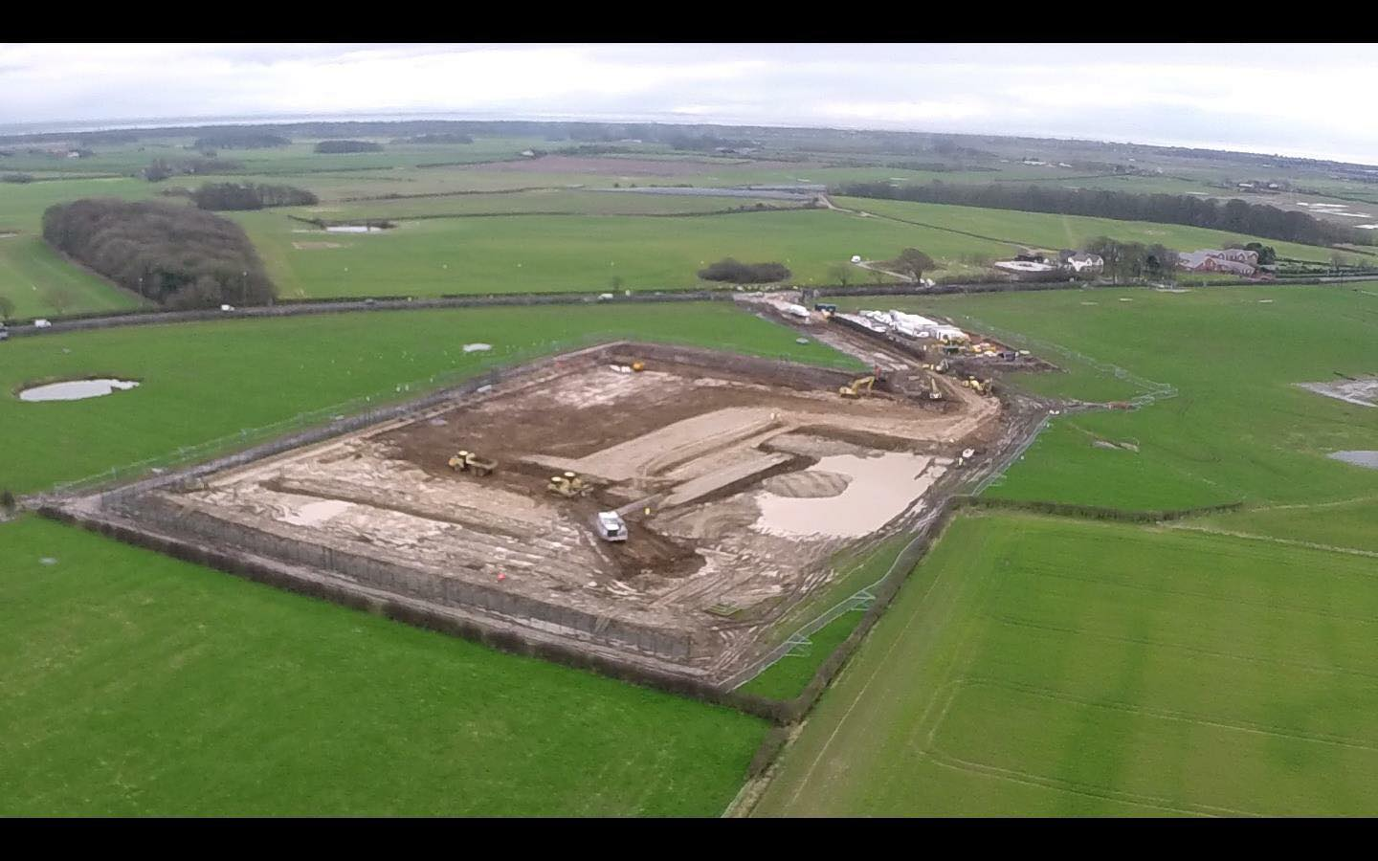
Gold Standards - Blackpool
Environment Agency requires 12 mths groundwater monitoring before development - Breached
3 warnings from the Environment Agency:
Inadequate surface water management facilities
Contaminated local stream with silt twice
Inadequate solid waste storage facilities
Health and Safety Executive requires Emergency plans in place (Borehole Regs) - Breached
Planning Application included safe management of lorries on the A583 – Breached – many accidents
Notes:
If we look at the gold standards that Cuadrilla are applying near Blackpool.
1 The Environmental Agency requires 12 mths of groundwater monitoring before development begins. This has been breeched and a petition is with the EA to get them to stop work until the monitoring is completed.
2 The planning application indicated strict traffic management on the lorries turning off the A583. This does not seem to be in place and several serious accidents have already happened.

Slide 21
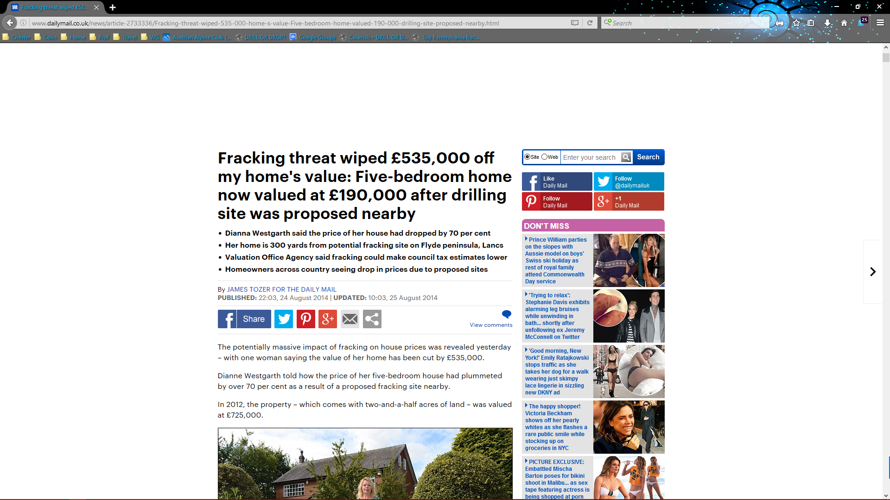
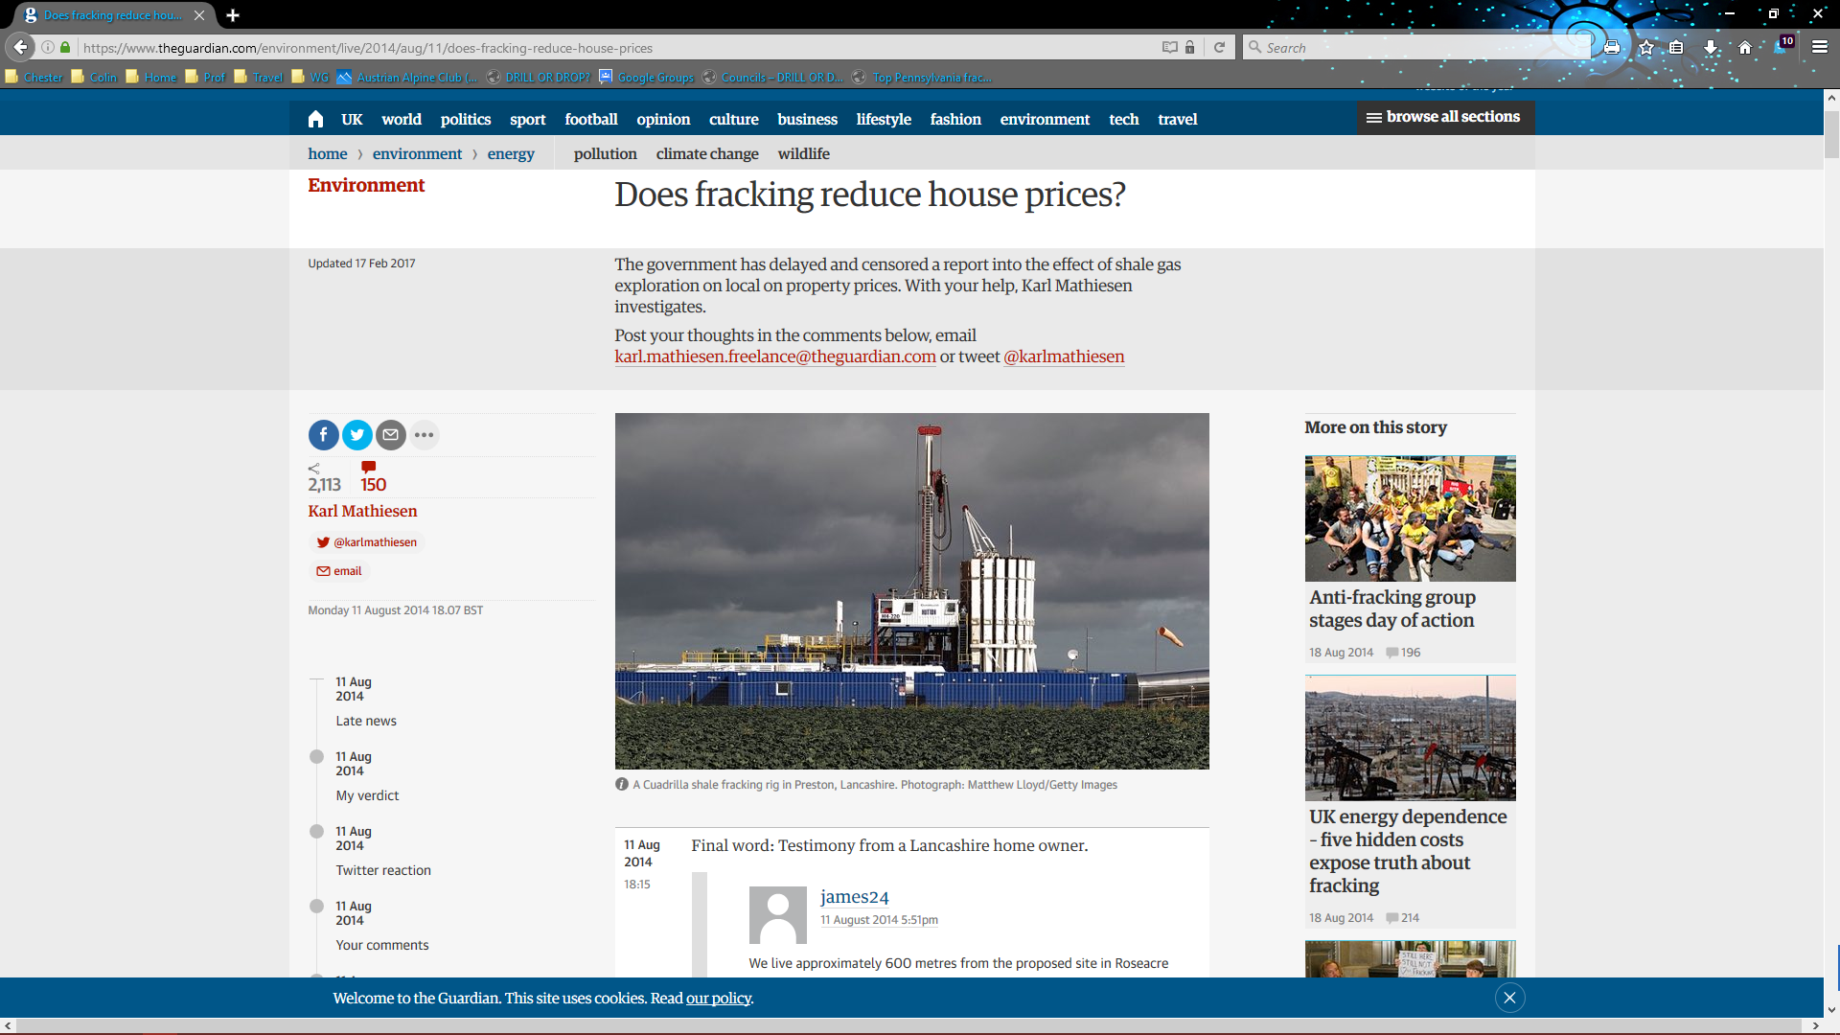
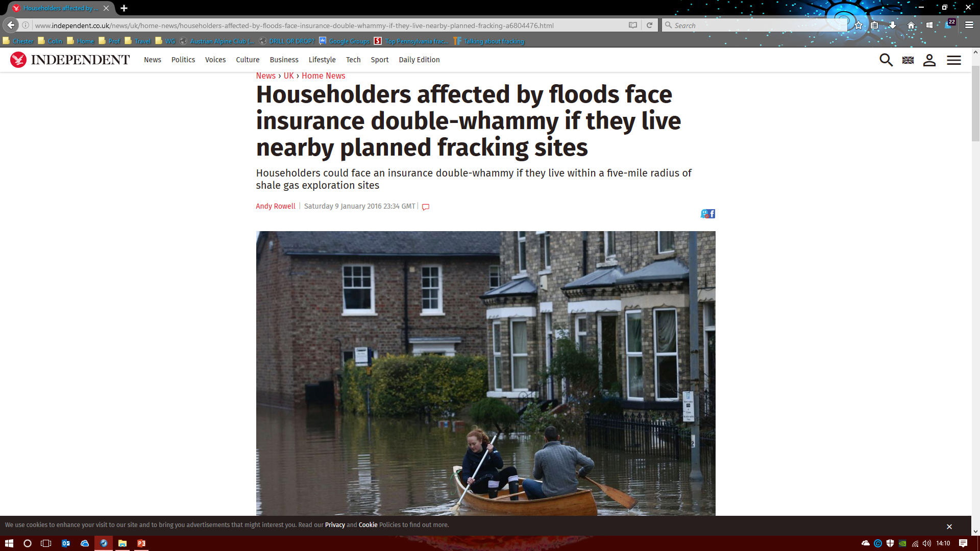
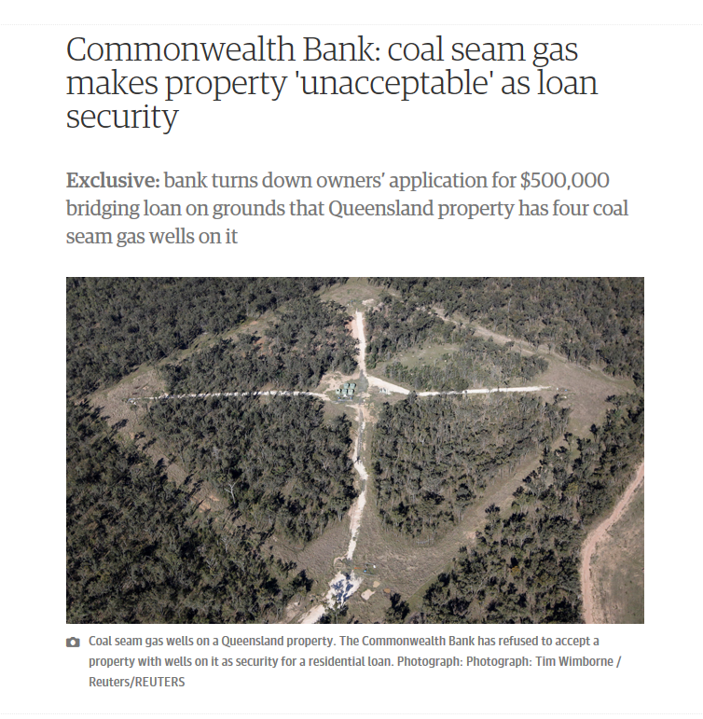
Housing
Daily Mail - Aug 2014
Guardian - Aug 2014
Independent – Jan 2016
Commonwealth Bank - Sept 2016
Notes:
Here is some anecdotal evidence on housing from the national press:
In Blackpool a house close to the fracking site was impacted dramatically. This house price dropped by 75%, Subsequently other houses in the area have seem similar losses
In Australia one of the biggest mortgage lenders stopped lending if unconventional gas extraction was taking place on or in the immediate vicinity of the property. Their logic was that no one knows what may happen in 25yrs, which is the lifetime of a traditional mortgage.
In the UK the government is withholding a report on expected falls in house prices. A leaked document indicates a 3 to 14% drop in house price.
Last year people that were impacted by floods had problems with their house insurance if the house was close to a fracking area.

Slide 22
Energy Security!
DECC/BGS Bowland Shale Gas Report- 2014
“37,600 Bm3 of gas - it is not possible to calculate the reserves”
US Energy Information Agency – Shale Gas in the UK 2015
“735 Bm3 technically recoverable reserves”
Gas independence for 7 yrs! - In practice 4 to 5 years
Notes:
We are often quoted energy security as the reason to frack.
The British Geological Survey in 2014 suggested there was 2,900 BCM of coal bed methane, of which 290 MCM was recoverable. This would last for three years at current consumption.
The British Geological Survey in 2014 suggested there was 37,600 BCM of shale gas in the ground, but did not know if it could be extracted and so concluded it was not possible to calculate how much was available.
The US Energy Information Agency who likes to know about these things reviewed our geological data and suggested there is 735 BCM of extractable shale gas under the UK.
From these analysis it can be derived that a completely fracked UK would give us between 3 to 9 years gas independence.
If you think these are dodgy number let me approach it from a different angle.

Slide 23
Improve everyone's awareness
Facebook / emails
Leaflets / notices in shops
Letters to the newspaper
Get Parish Council to say no
Object to the CW&C application
Build alliances
Let you voice be known
We need to get the Conservatives to change policy – or change the government!

Slide 24
Would you like to find out more?
Google “Fracking + Health”
Ask yourself “do you want to live in a gas field?”

